Slide 1
Introduction to distributed databases

Slide 2
Overview over this video
In this video, we will see what a distributed database is and why they are important

Slide 3
Motivation
Sales, inventory
CS_Stores
Chain of
Each site stores only data primarily relevant to it
Distributed DBMS provide access to data at all sites
Sales, inventory
Manchester
Liverpool
Sales, inventory
Employees, customers,
suppliers, …
London
Central Office
Query about sales in Manchester

Slide 4
Motivation
Sales, inventory
Chain of CS_Stores
Each site stores only data primarily relevant to it
Distributed DBMS provide access to data at all sites
Sales, inventory
China
UK
Sales, inventory
Employees, customers,
suppliers, …
USA
Central Office
Query about sales in China

Slide 5
Other Applications
More general: large organisations/companies
…with different branches or offices
…with different sub-companies
…or simply so large that one computer can’t handle all the request
Providing access to large datasets to many users (e.g., for an online store)
Distribute data over several computers – not necessarily identical (in software or hardware)
Computers could be at geographically separate locations (but also possible that they are the same place)
Possible advantages:
Balance workload & network traffic
Easier to extend capacity or scale to higher number of users

Slide 6
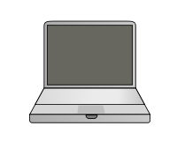
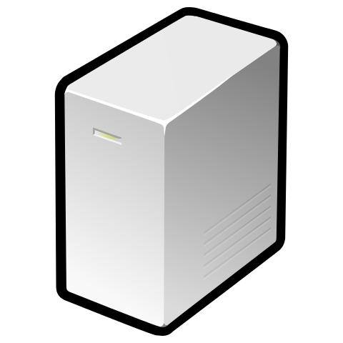
From “introduction to databases” video
User
Amazon.com
Database
> 42 TB of data
> 60 million active users
millions of products
millions of users per day many at the same time
100s of servers

Slide 7
Distributed Databases
Distributed Database:
Collection of multiple logically interrelated databases
Distributed over a computer network
Distributed DBMS: manages a distributed database
B
Node/site = computer in the network, where a database is stored
A
Network link
C

Slide 8
Advantages
Performance improvements
Answer queries faster by distributing tasks over the nodes
Reduces CPU time, disk accesses, communication cost, … at individual nodes
Scalability
Easier extension of the system: capacity, performance, …
Essentially just add a new node
Resilience
Data can be replicated at geographically separate sites
Catastrophic failures don’t affect the entire system

Slide 9
Summary
A distributed database is a database made up of multiple logically interrelated databases that is based on multiple different computers, distributed over a network

